Slide 1

INSTITUTE - UIE
DEPARTMENT- ACADEMIC UNIT-2
Bachelor of Engineering (Computer Science & Engineering)
Subject Name: Introduction to Problem Solving
Code:22CSH-101
Pointers: Functions returning Pointer, Storage Classes
DISCOVER . LEARN . EMPOWER

Slide 2


Introduction to Problem Solving
Course Objectives
The course aims to provide exposure to problem-solving through programming.
The course aims to raise the programming skills of students via logic building capability.
With knowledge of C programming language, students would be able to model real world problems.

Slide 3



Course Outcomes
CO Number | Course Outcome
CO1 | Remember the concepts related to fundamentals of C language, draw flowcharts and write algorithm/pseudocode.
CO2 | Understand the way of execution and debug programs in C language.
CO3 | Apply various constructs, loops, functions to solve mathematical and scientific problem.
CO4 | Analyze the dynamic behavior of memory by the use of pointers.
CO5 | Design and develop modular programs for real world problems using control structure and selection structure.

Slide 4
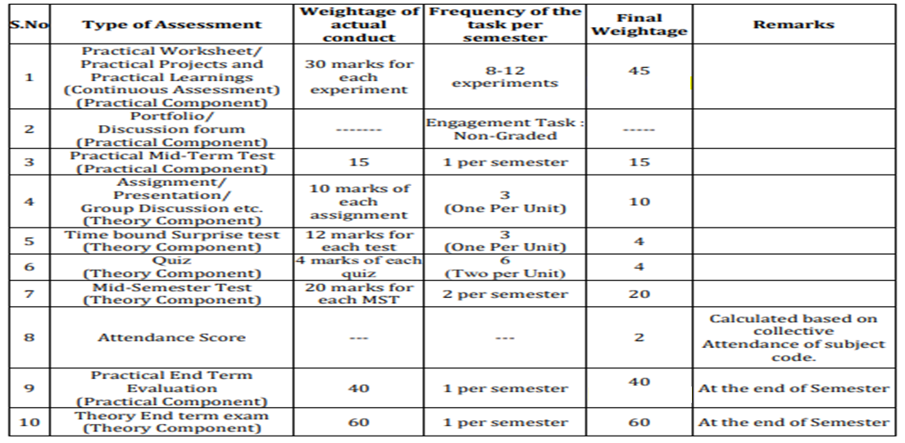
Scheme of Evaluation

Slide 5
Storage Classes
Storage Classes defines the scope and life time of variable declare in a function.
Types of Storage Classes
Auto ( Automatic ) storage class
Static storage class
Extern ( External ) storage class
Register storage class

Slide 6
Auto (Automatic) storage class - Auto variables
Auto variables have local scope. All the variables declared in function are auto, by default. We can declare same variables in different functions as well.
The auto keyword is optional, there is no need to write it.
All the formal arguments have auto scope.
If not initialized auto variables have garbage value.
The value is lost after the execution of function.
Syntax of auto storage class:
auto Data-type Variable-name;
OR
Data-type Variable-name;

Slide 7
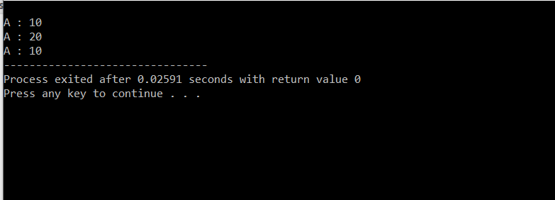
Example of auto storage class
#include<stdio.h>
void display();
int main()
{
auto int a=10; //OR int a=10;
printf("\nA : %d",a);
display();
printf("\nA : %d",a);
}
void display()
{
int a=20; //OR auto int a=20;
printf("\nA : %d",a);
}
Output:

Slide 8
Static storage class - Static variables
Static variable also have local scope as automatic variables. During multiple calling static variables retains their previous value.
We must declare variable as static.
Static variables can't be accessed outside the function.
If not initialized static variables have zero as initial value.
Syntax of static storage class:
static Data-type Variable-name;

Slide 9
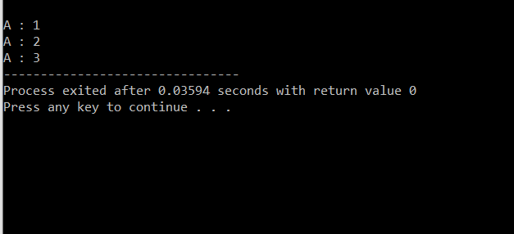
Example of static storage class:
#include<stdio.h>
void display();
int main()
{
display();
display();
display();
}
void display()
{
static int a=1;
printf("\nA : %d",a);
a++;
}
Output:

Slide 10
Extern (External) storage class - External variables
External variables have global scope. They are declared outside all the functions.
The extern keyword is optional, there is no need to write it.
The scope of external variable is the entire program.
If not initialized external variable is assigned a zero value.
The value is not lost after the execution of function.
One function can assign value and another can display the value.
Syntax of external storage class or global variable
extern Data-type Variable-name;
OR
Data-type Variable-name;

Slide 11
Example of external storage class or global variable
#include<stdio.h>
void display();
int a=10; //global variable
int main()
{
printf("\nA : %d",a);
increment();
display();
printf("\nA : %d",a);
}
void increment()
{
a = 20;
}
void display()
{
printf("\nA : %d",a);
}
a++;
}
Output:
A : 10
A : 20
A : 20

Slide 12
Register storage class - Register variables
Register variables have local scope as automatic variables. They are declared within motherboard's register memory. All the arithmetic and logical operations are carried out within these registers.
These variables are stored in registers. If registers are not available values are stored in main memory.
Register variables works faster then other kind of variables because register memory is fatser then main memory.
Address operator '&' can't be used with these variables.
Pointer to register variables are not allowed.
These variables are used for loops to increase efficiency.
Syntax of register storage class:
register Data-type Variable-name;

Slide 13
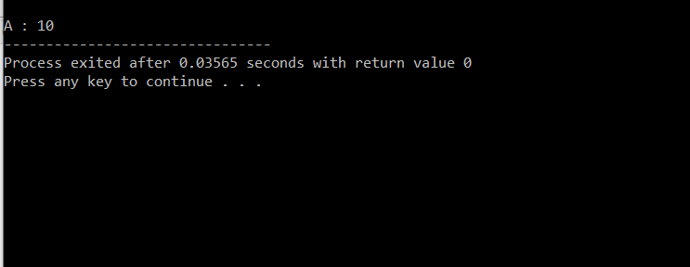
Example of register storage class
include<stdio.h>
int main()
{
register int a=10;
printf("\nA : %d",a);
}
Output:

Slide 14
The table summarizes the principal features of each storage class which are commonly used in C programming:
Storage Class | Declaration | Storage | Default Initial Value | Scope | Lifetime
auto | Inside a function/block | Memory | Unpredictable | Within the function/block | Within the function/block
register | Inside a function/block | CPU Registers | Garbage | Within the function/block | Within the function/block
extern | Outside all functions | Memory | Zero | Entire the file and other files where the variable is declared as extern | program runtime
Static (local) | Inside a function/block | Memory | Zero | Within the function/block | program runtime
Static (global) | Outside all functions | Memory | Zero | Global | program runtime

Slide 15
Summary
C programming allows passing a pointer to a function. To do so, simply declare the function parameter as a pointer type.
In call by value method, the value of the actual parameters is copied into the formal parameters.
When an array is declared, compiler allocates sufficient amount of memory to contain all the elements of the array.
C also allows to return a pointer from a function.
In call by reference, the address of the variable is passed into the function call as the actual parameter.

Slide 16
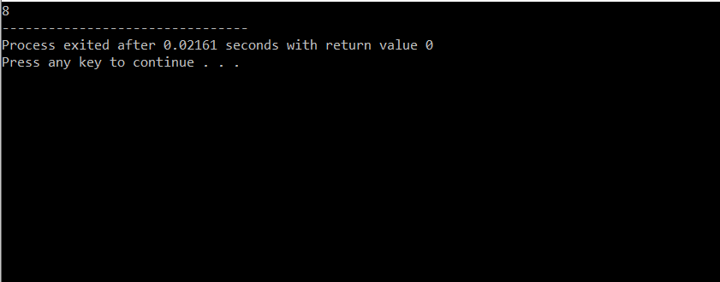
Frequently Asked question
Q1:What will the Output of the Program?
#include<stdio.h>
int main()
{
printf("%d", sizeof(void *));
return 0;
}
Output:

Slide 17
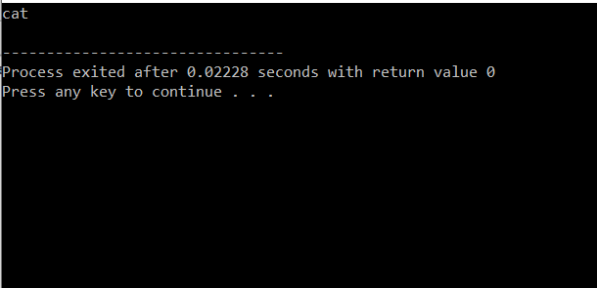
2) What will be the Output?
#include<stdio.h>
void function(char**);
int main()
{
char *arr[] = { "ant", "bat", "cat", "dog", "egg", "fly" };
function(arr);
return 0;
}
void function(char **ptr)
{
char *ptr1;
ptr1 = (ptr += sizeof(int))[-2];
printf("%s\n", ptr1);
}
return (0);}
Output:

Slide 18
Q3) What is “&” and “*” operators in C?
Ans:
1. “*” Operator is used as pointer to a variable. Example: * a where * is pointer to the variable a.
& operator is used to get the address of the variable. Example: &a will give address of a.
Q4) WHAT IS VOID POINTER IN C?
Ans:
Void pointer is a generic pointer that can be used to point another variable of any data type.
Void pointer can store the address of variable belonging to any of the data type. So, void pointer is also called as general purpose pointer.

Slide 19
Assessment Questions:
What will be the output of the C program?
#include<stdio.h>
int main(){
int a = 25, b;
int *ptr, *ptr1;
ptr = &a;
ptr1 = &b;
b = 36;
printf("%d %d",*ptr, *ptr1);
return 0;
}
2. What will be the output of the C program?
#include<stdio.h>
int main(){
int * ptr ;
printf("%d", sizeof(ptr));
return 0;
}

Slide 20
3. What will be the output of the C program?
#include<stdio.h>
int main()
{
char *str = "His";
int i;
for(i = 0; i < strlen(str); i++)
printf("%s", str++);
return 0;
}

Slide 21

Discussion forum.
Write a program in C to add numbers using call by reference.

Slide 22

REFERENCES
Reference Books
Programming in C by Reema Thareja.
Programming in ANSI C by E. Balaguruswamy, Tata McGraw Hill.
Programming with C (Schaum's Outline Series) by Byron Gottfried Jitender Chhabra, Tata McGraw Hill.
The C Programming Language by Brian W. Kernighan, Dennis Ritchie, Pearson education.
Websites:
https://www.programiz.com/c-programming/c-pointer-functions
https://www.studytonight.com/c/pointer-with-function-in-c.php
http://www.tutorialdost.com/C-Programming-Tutorial/17-C-Pointers.aspx
YouTube Links:
http://www.digimat.in/nptel/courses/video/106104128/L38.html

Slide 23
THANK YOU

